Slide 1
MIT Deep reinforcement learning Lecture: Summary and Takeaways
Scott O’Hara
Metrowest Developers Machine Learning Group
03/06/2019

Slide 2
Deep Reinforcement Learning Lecture at MIT(Jan 22, 2019)
Prof. Lex Fridman
Lecture is part of an introductory class on deep learning (6.S091)
The course is an Independent Activities Period (IAP) at MIT.
Website: https://deeplearning.mit.edu/
Also see: http://introtodeeplearning.com/

Slide 3
Lecture Summary
The 1st quarter of the lecture was spent motivating deep learning and reinforcement learning and giving context in the wider developments and goals in AI
Dr Fridman spent the 2nd quarter of the lecture covering general reinforcement learning (RL) that we covered last year, including the grid world example.
The second half of the lecture introduced deep reinforcement learning (DRL) where DRL = RL + NN. He surveyed various DRL algorithms and techniques with extended discussion of deep Q-learning (DQN) and AlphaGo.

Slide 4

Personal Takeaways
All machine learning is "supervised" by a loss function where supervised learning is described as "learning by example" and reinforcement learning is described as "learning by experience".
The relationship between deep learning and deep reinforcement learning can be characterized in a kind of robotic process loop framework i.e.,
perceive $→$ represent $→$ learn $→$ action

Slide 5
Personal Takeaways (2)
Deep Q-learning can be viewed as approximate Q-learning where the Q(s,a) array is replaced by a deep neural network Q(s,a |dNN).
Realistic simulation of the real world is very important for training deep reinforcement learning agents.
For the most part, deep learning is NOT being used in current real world robots or driverless cars but this may be changing.

Slide 6
different kinds of machine learning

Slide 7
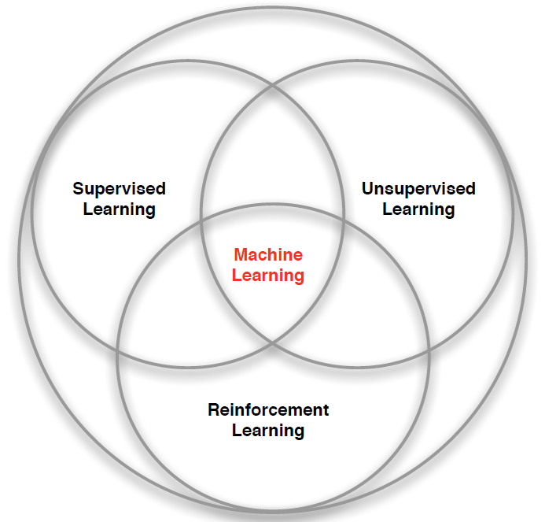
branches of Machine Learning
Credit: adapted from lecture slides David Silver, DeepMind, “Introduction to Reinforcement Learning

Slide 8
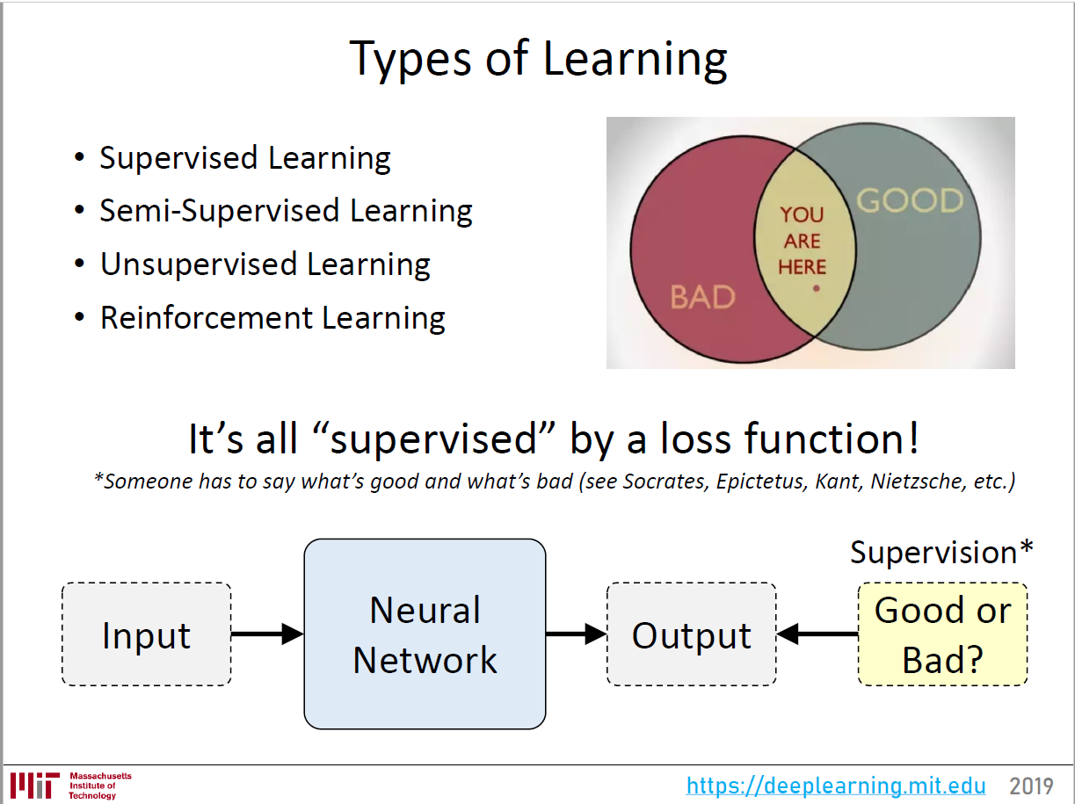

Slide 9
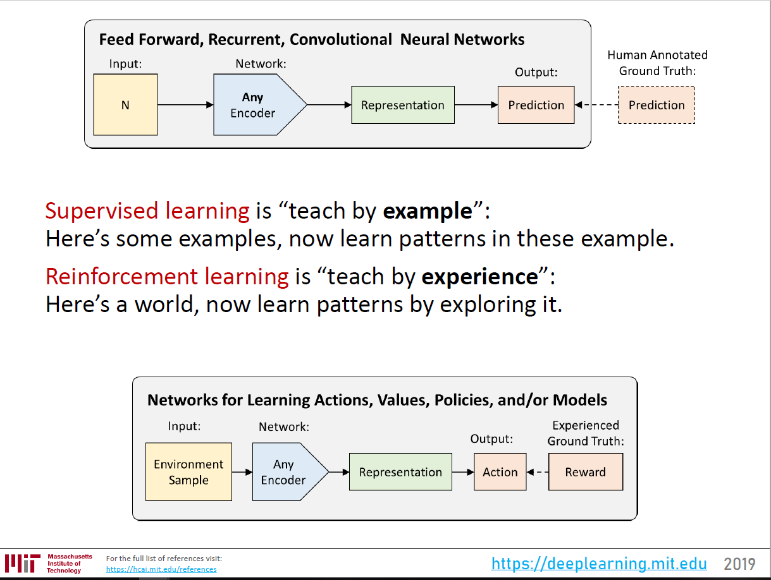

Slide 10
deep learning and deep reinforcement learning

Slide 11
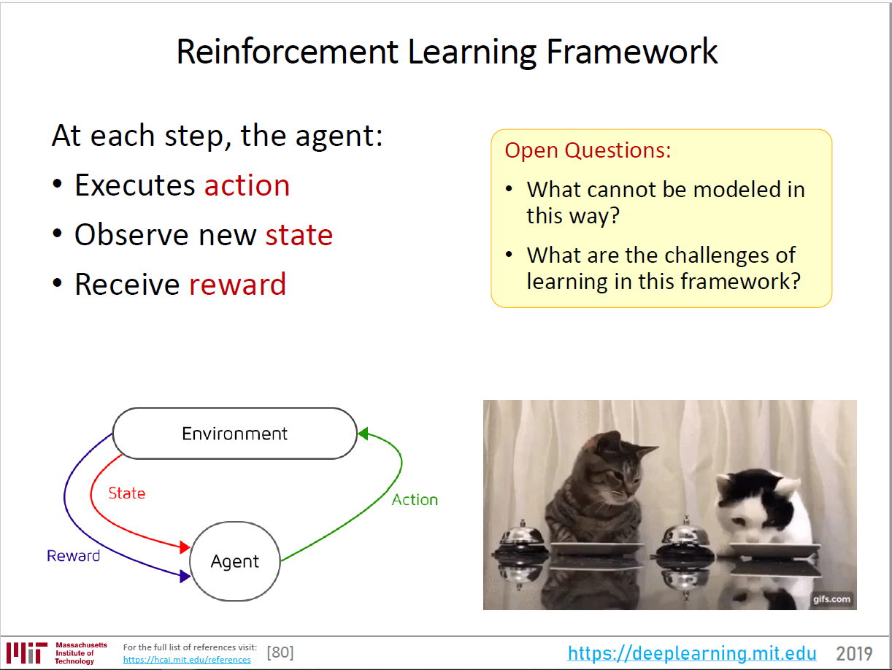

Slide 12
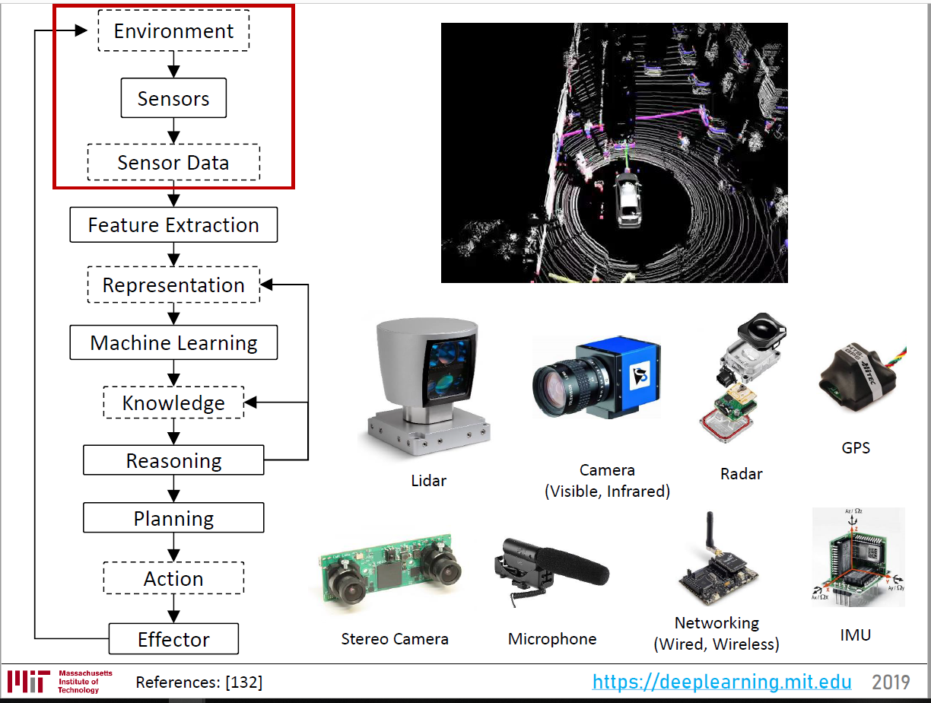

Slide 13
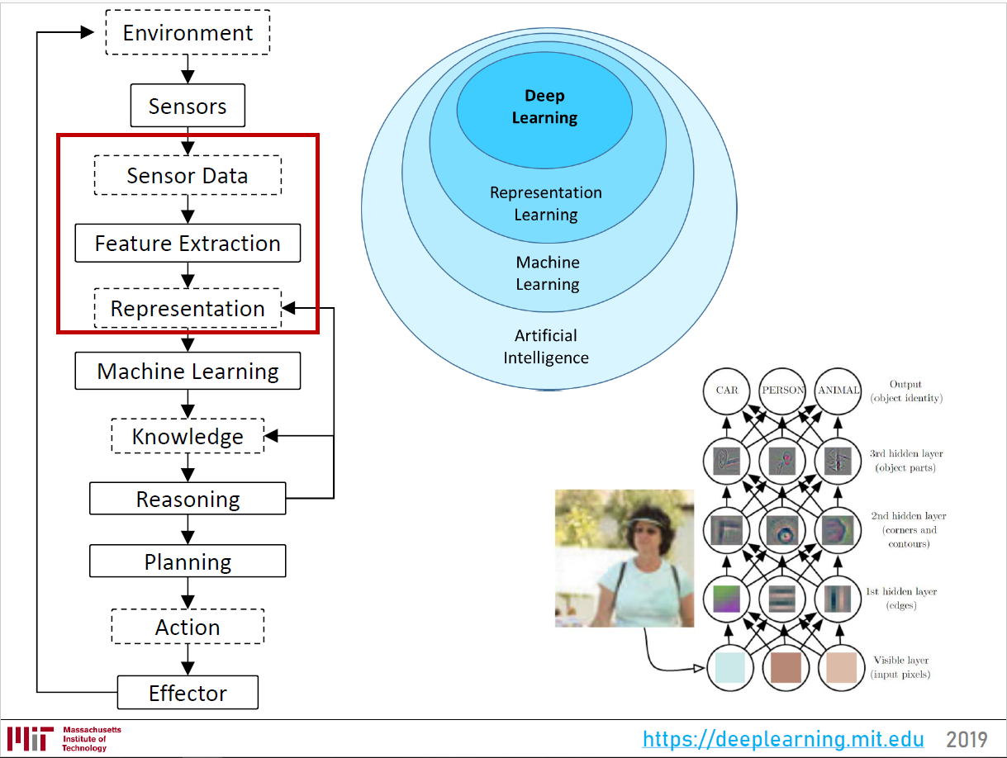

Slide 14
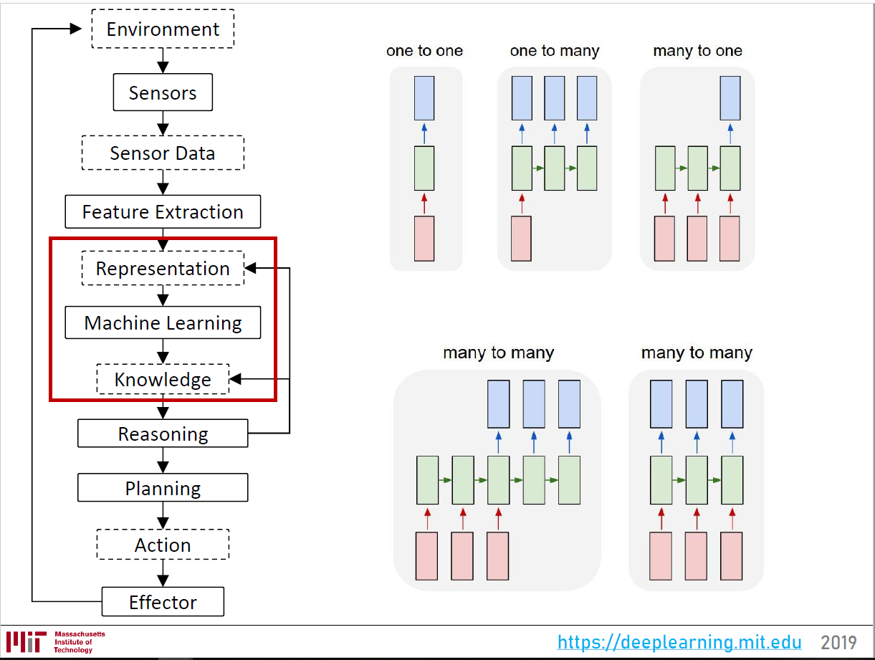

Slide 15
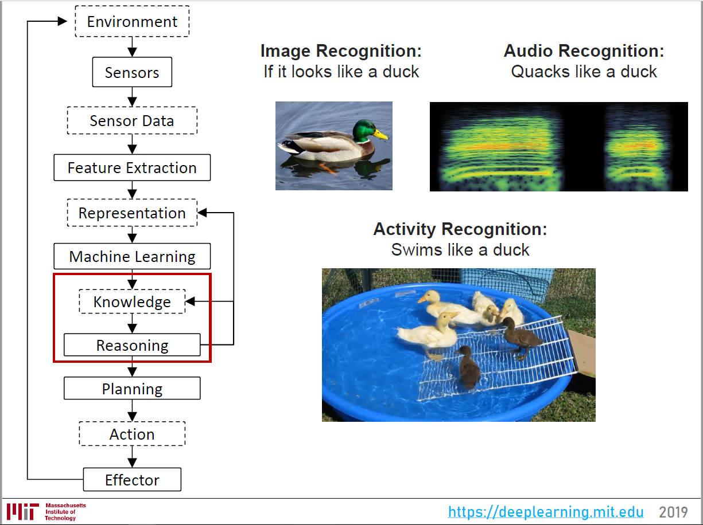

Slide 16
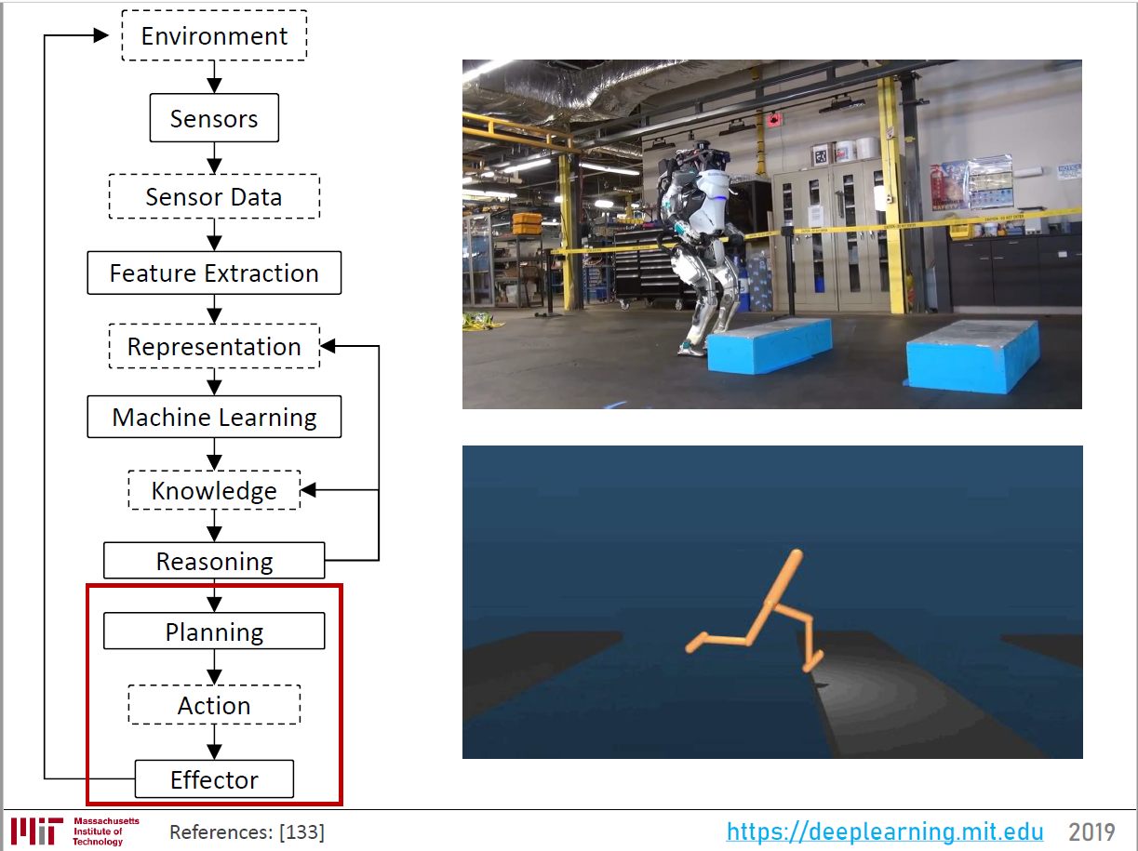

Slide 17
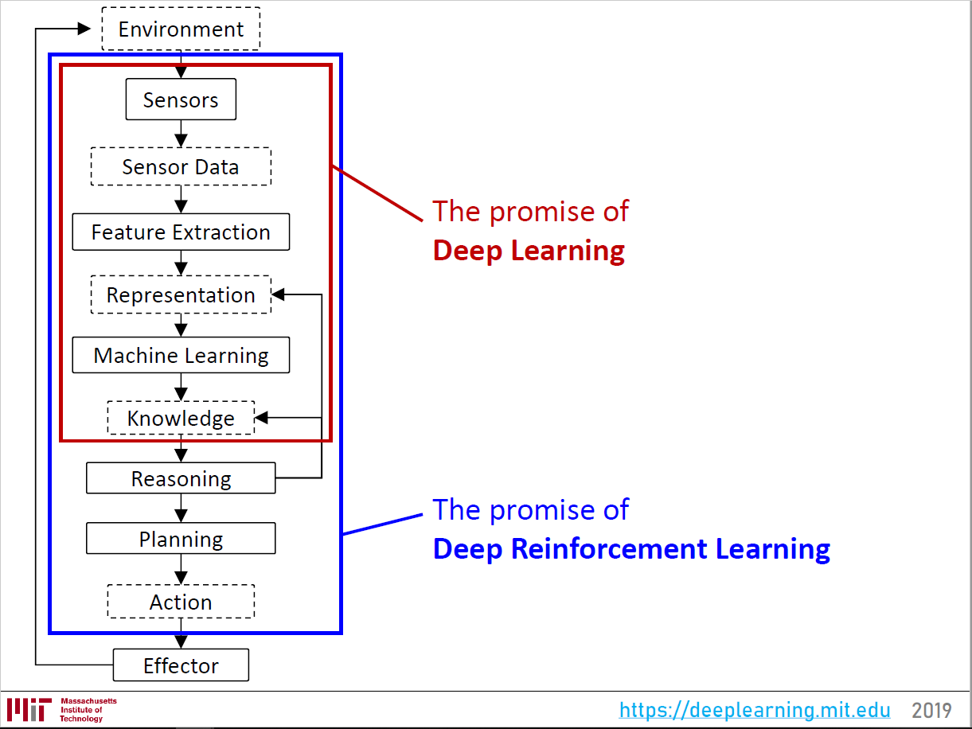

Slide 18
Q-Learning and Deep Q-Learning

Slide 20





Grid World
A maze-like problem
The agent lives in a grid
Walls block the agent’s path
Noisy movement: actions do not always go as planned
80% of the time, the action North takes the agent North (if there is no wall there)
10% of the time, North takes the agent West; 10% East
If there is a wall in the direction the agent would have been taken, the agent stays put
The agent receives rewards each time step
Small “living” reward each step (can be negative)
Big rewards come at the end (good or bad)
Goal: maximize sum of rewards
Notes:
[cut demo of moving around in grid world program]

Slide 21
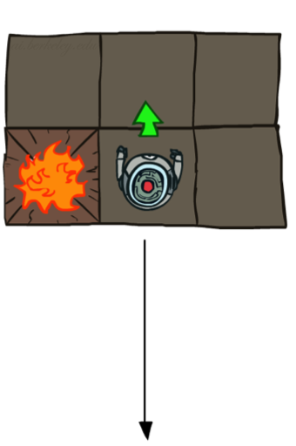
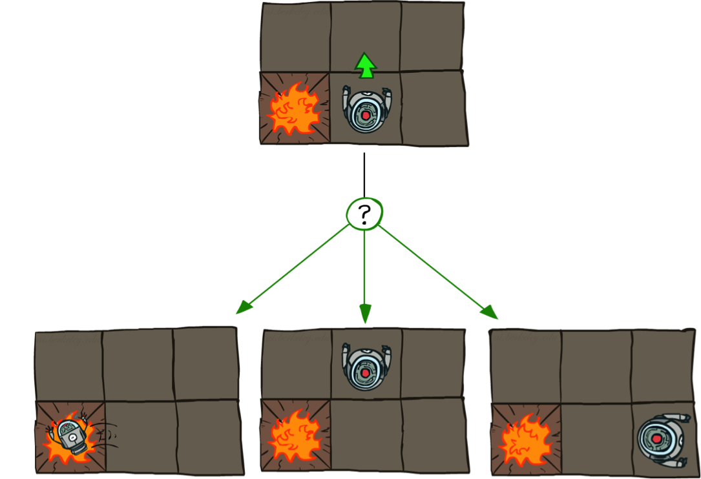

Grid World Actions
Deterministic Grid World
Stochastic Grid World

Slide 22

Q-Learning update rule
On transitioning from state s to state s’ on action a, and receiving reward r, update:
$α$ is the learning rate
A large $α$ results in quicker learning but may not converge.
$α$ is often decreased as learning goes on.
$γ$ is the discount rate i.e., discounts future rewards
$$Q\left(s,a\right)←\left(1−α\right)Q\left(s,a\right)+α\left[r+γ\max_{a′}{Q_{k}\left(s′,a′\right)}\right]$$

Slide 23
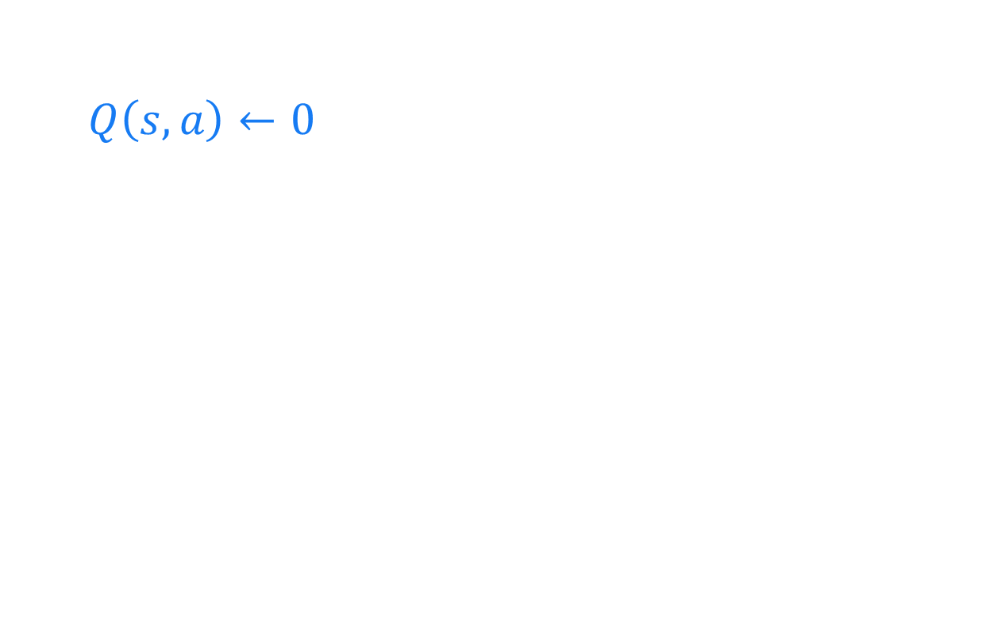
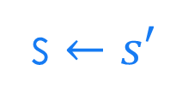
Q-Learning algorithm
For each state s and action a:
$Q\left(s,a\right)←0$
Begin in state s:
Repeat:
For all actions associated with state s, → CHOOSE ACTION a ← based on the Q values for state s
Receive reward r and transition to s’
s $←s′$

Slide 24
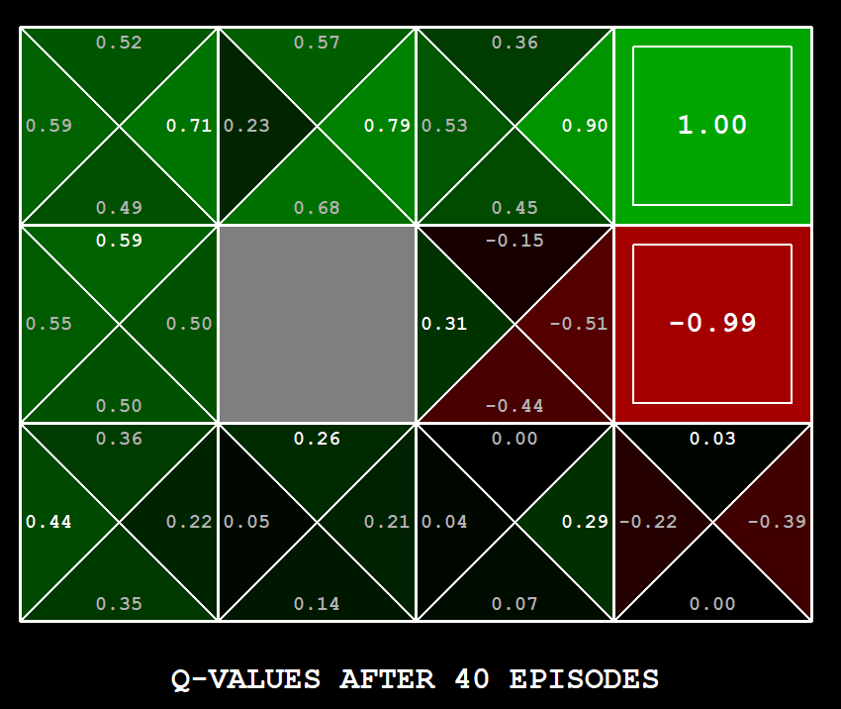
Q-Learning Example: gridworld
Notes:
python gridworld.py -k 40 -w 200 -s 2.0 -a q –v [-p]

Slide 25
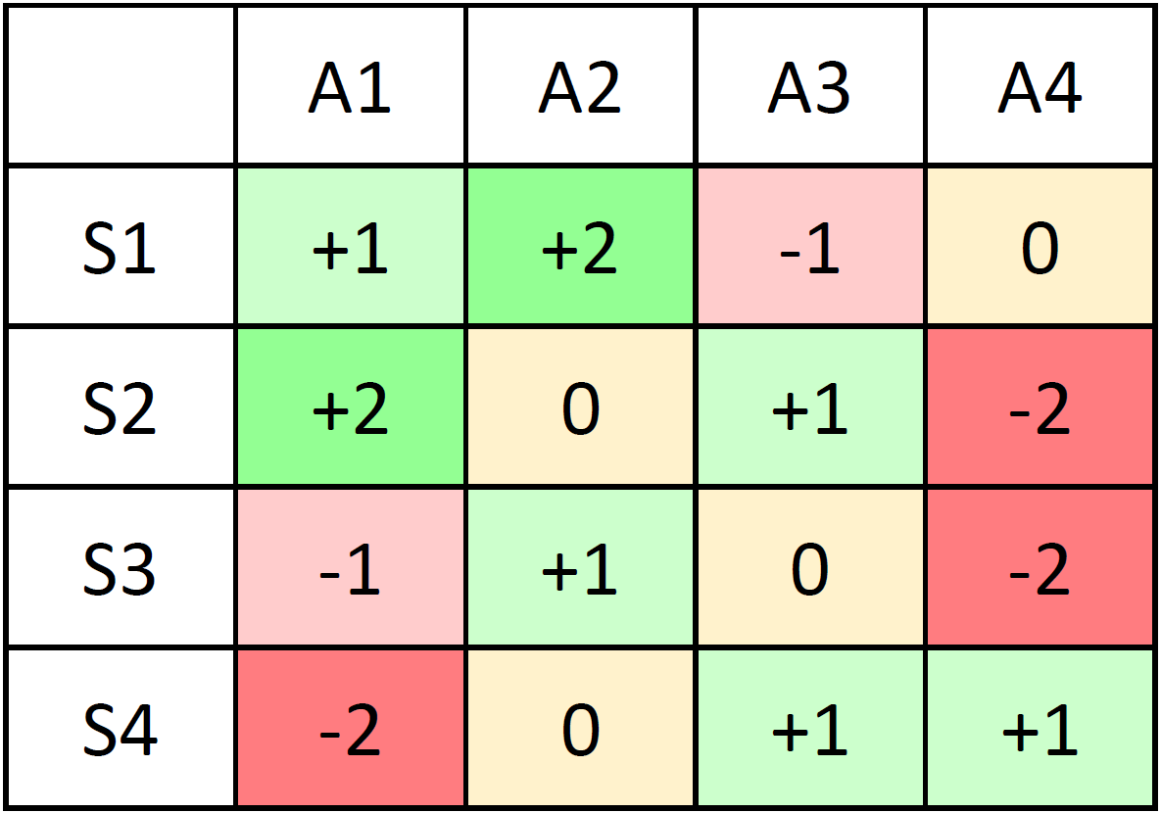
Q Function: Q(S,A)
Action A
State S

Slide 26
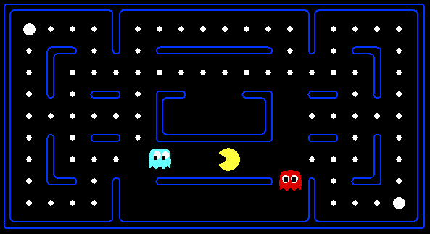



Example: Pacman
Let’s say we discover through experience that this state is bad:
In naïve q-learning, we know nothing about this state:
Or even this one!
Credit: CS188 – Intro to AI, UC Berkeley, ai.berkely.edu

Slide 27

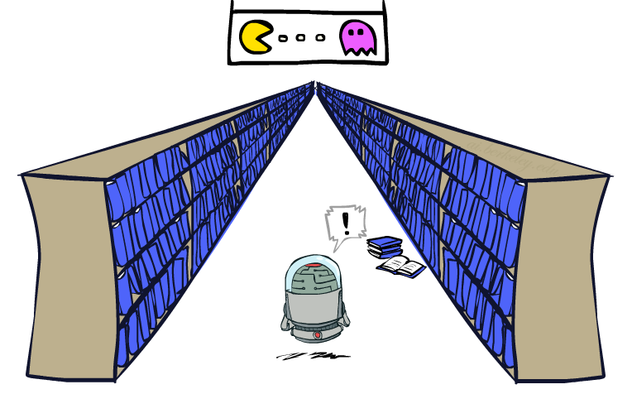
Generalizing Across States
In realistic situations, we cannot possibly learn about every single state!
Too many states to visit them all in training
Too many states to hold the q-tables in memory
Instead, we want to generalize:
Learn about some small number of training states from experience
Generalize that experience to new, similar situations

Slide 28


Approximate Q-Learning
Describe a state using a vector of features (properties)
Features are functions from states to real numbers (often 0/1) that capture important properties of the state
Example features:
Distance to closest ghost
Distance to closest dot
Number of ghosts
1 / (dist to dot)²
Is Pacman in a tunnel? (0/1)
…… etc.
Credit: CS188 – Intro to AI, UC Berkeley, ai.berkely.edu

Slide 29
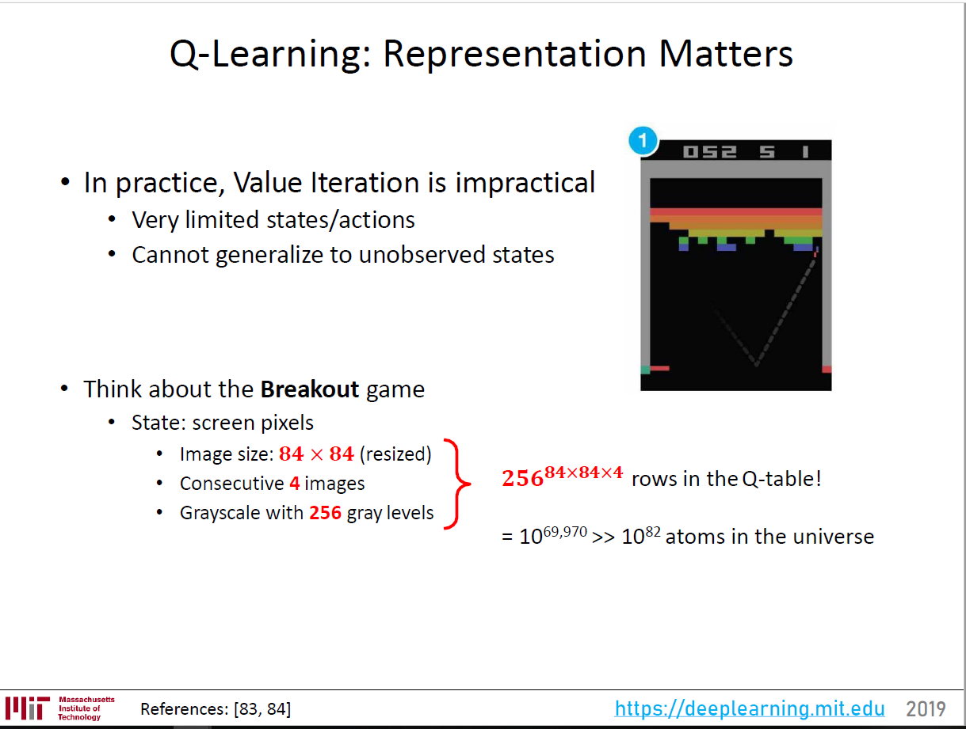

Slide 30
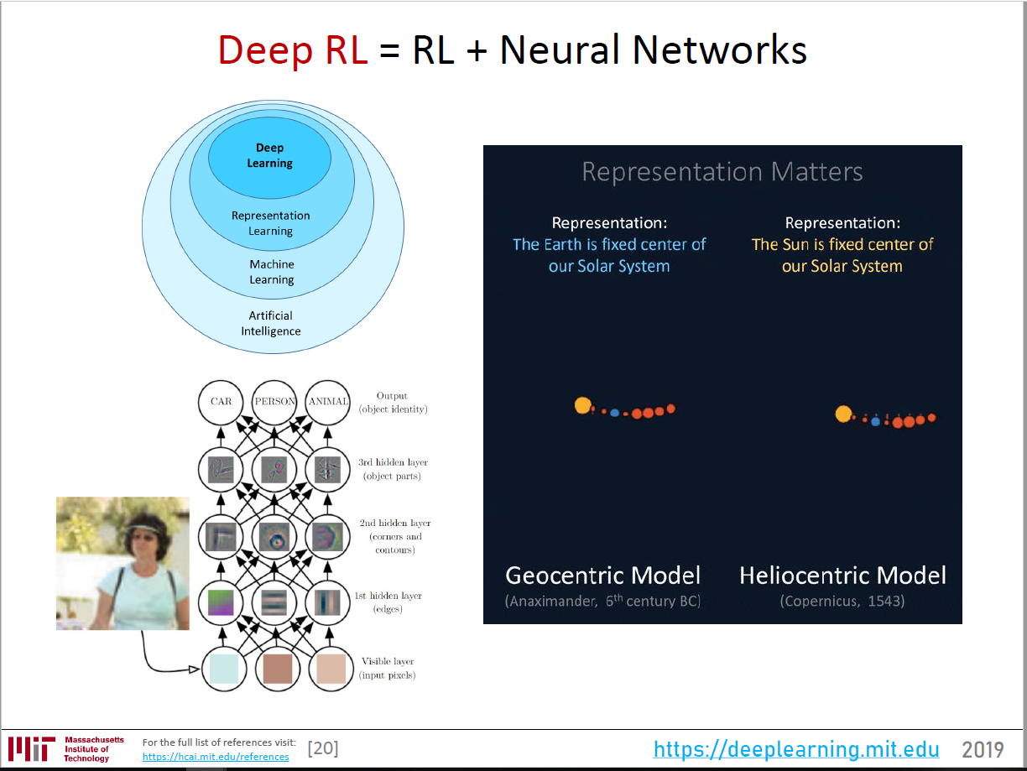

Slide 31
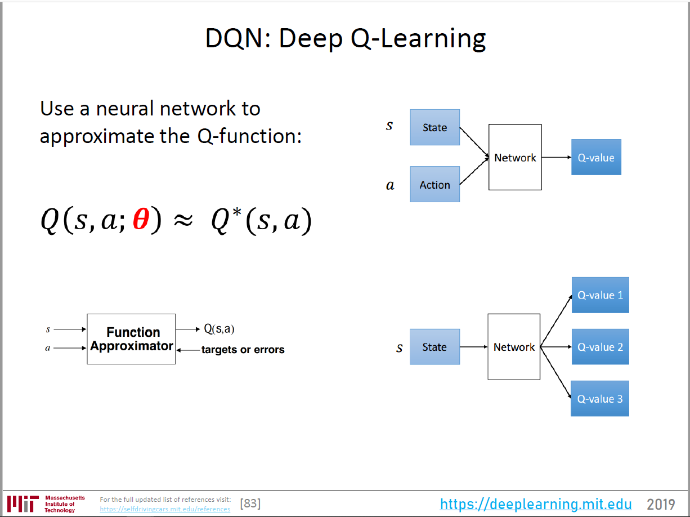

Slide 32
Training real-world reinforcement learning agents

Slide 33
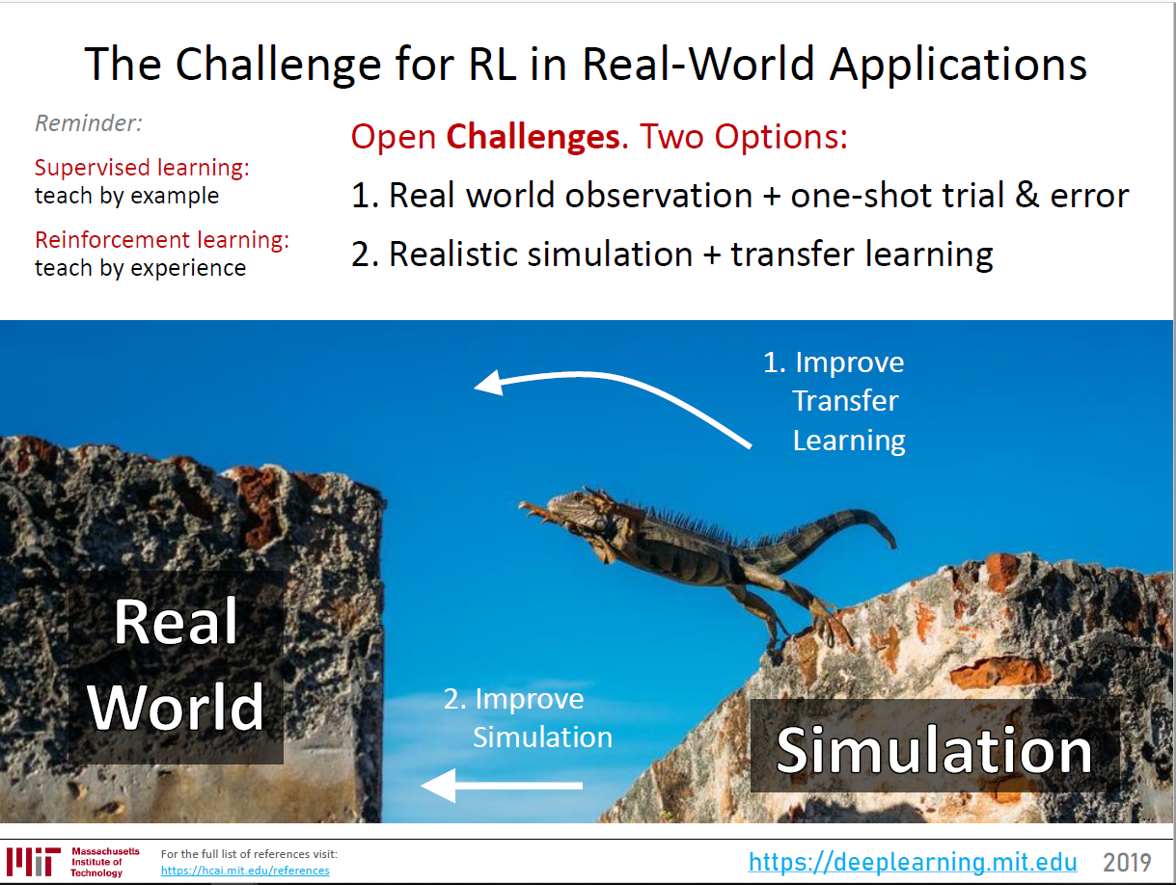

Slide 34
Want these slides?
Email Scott O’Hara at seohara@gmail.com and ask me for them.

